Slide 1
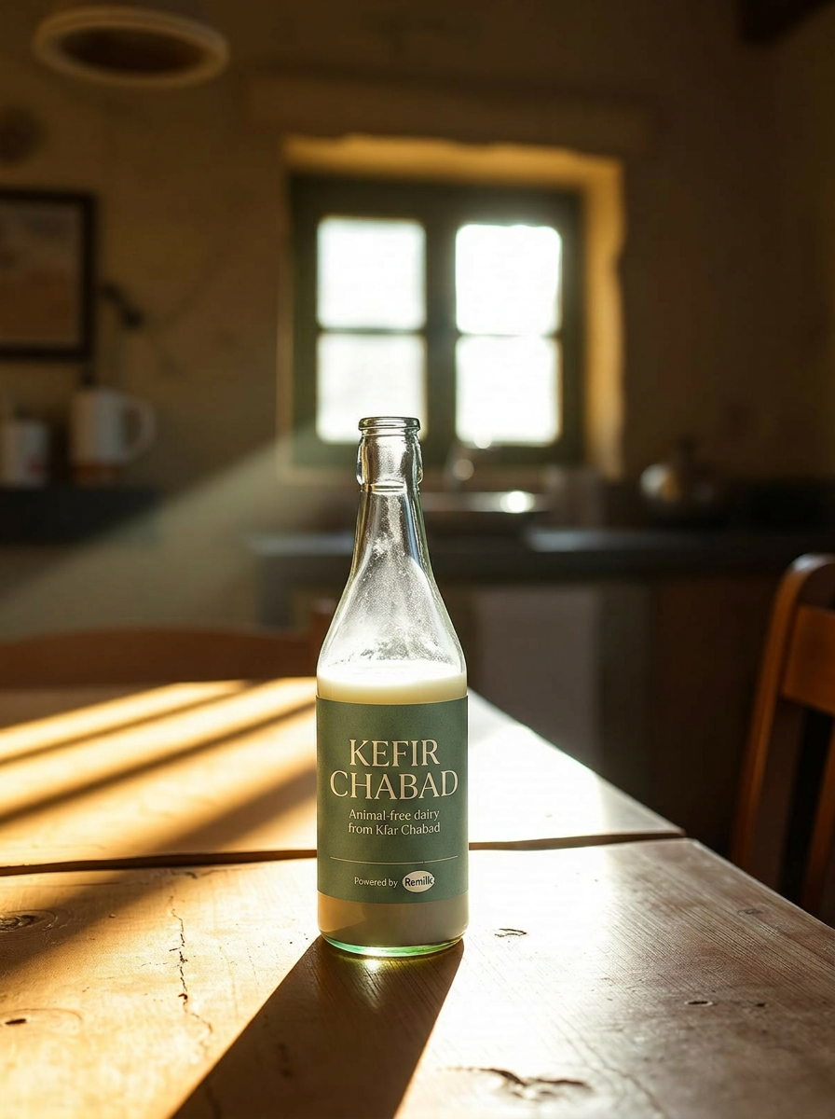
A PITCH TO REMILK
Kefir Chabad
כפיר חב״ד
Heritage dairy, reimagined.
A kosher-pareve, animal-free brand built on Remilk protein —
crafted in Kfar Chabad for Israel and the global Jewish market.
Prepared for the Remilk team · 2026
Kefir Chabad · כפיר חב״ד
1 / 11

Slide 2
THE OPENING
Remilk has the protein.
Israel needs the brand.
You've cracked precision-fermented dairy and partnered with Gad Dairies for Israel's first commercial launch in 2026. The category is real. What's missing is a brand that speaks fluently to the audience most likely to adopt it first — observant Jewish households who keep kosher every day.
Kefir Chabad is that brand.
Kefir Chabad · כפיר חב״ד
2 / 11

Slide 3
WHY THIS, WHY NOW
A category window opens once.
01
02
03
Kosher complexity
Lactose-free by nature
Climate without compromise
Traditional dairy forces a 6-hour wait after meat. Remilk's protein is rabbinically certified pareve — kosher dairy that pairs with anything.
36% of US adults and a meaningful share of Israelis are lactose-intolerant. The protein is identical to milk; the discomfort isn't.
Same taste, texture, and nutrition. Without the cow, the methane, or the supply-chain fragility exposed since 2023.
Kefir Chabad · כפיר חב״ד
3 / 11

Slide 4
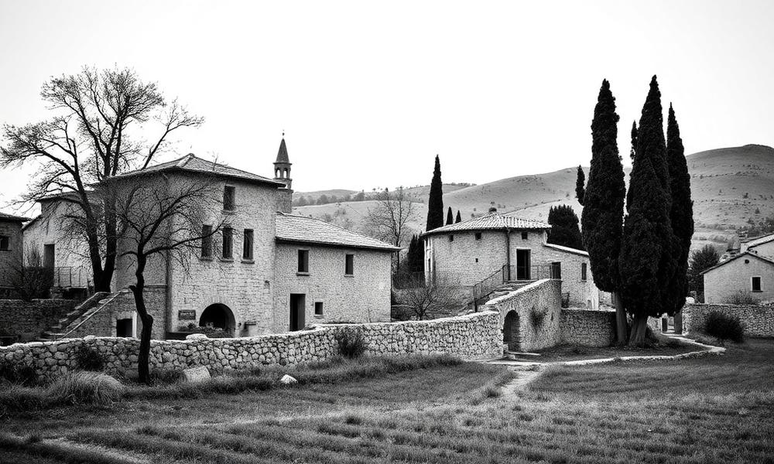
THE BRAND
Heritage you can taste.
Kefir Chabad borrows the warmth, ritual, and trust of Kfar Chabad — one of Israel's most recognized observant communities — and reframes it for 2026 dairy.
VOICE
Quiet, warm, confidently modern.
VISUAL
Cream paper, deep berry ink, hand-set serif.
PROMISE
Real dairy. Zero cows. Always pareve.
Kefir Chabad · כפיר חב״ד
4 / 11

Slide 5
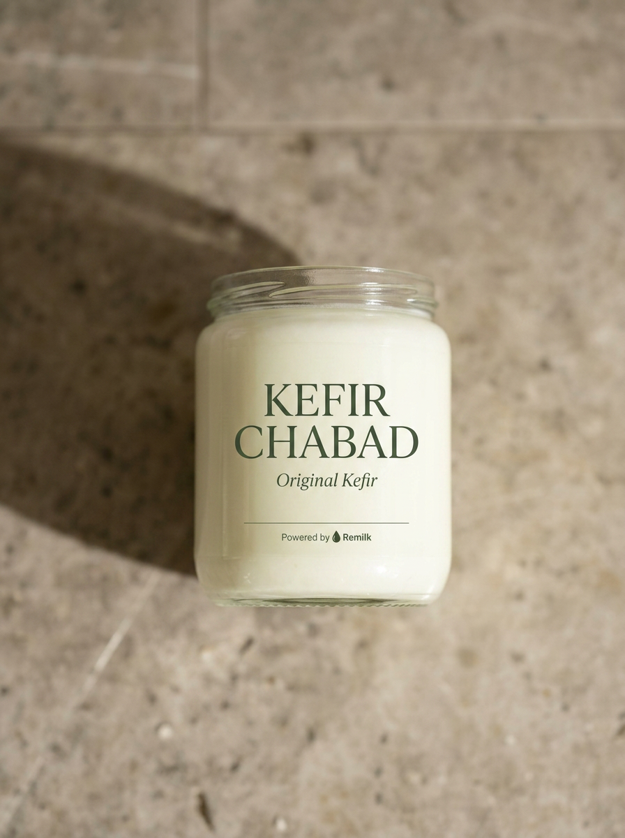
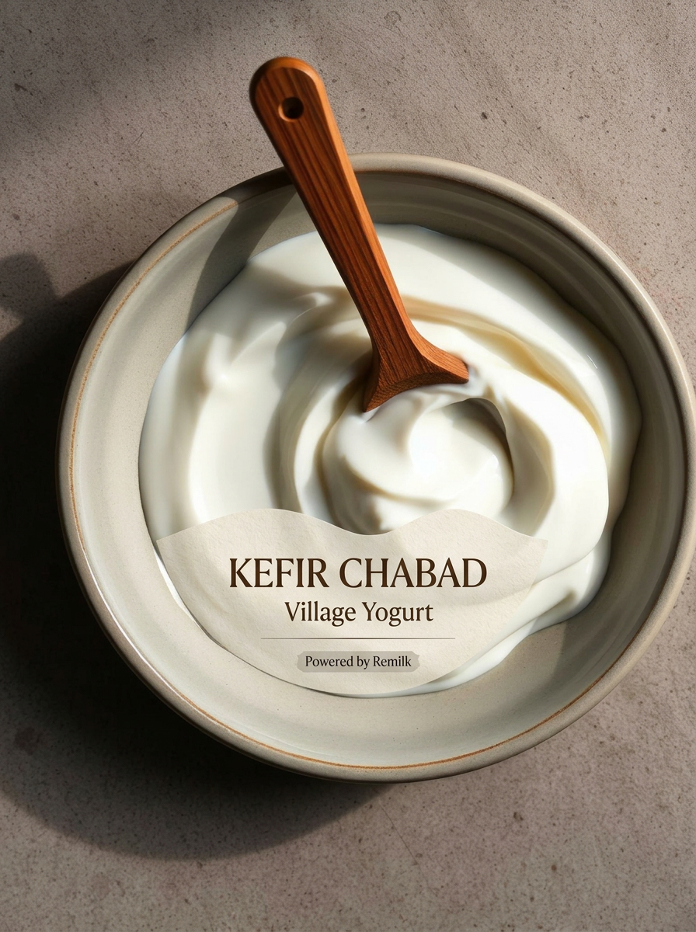
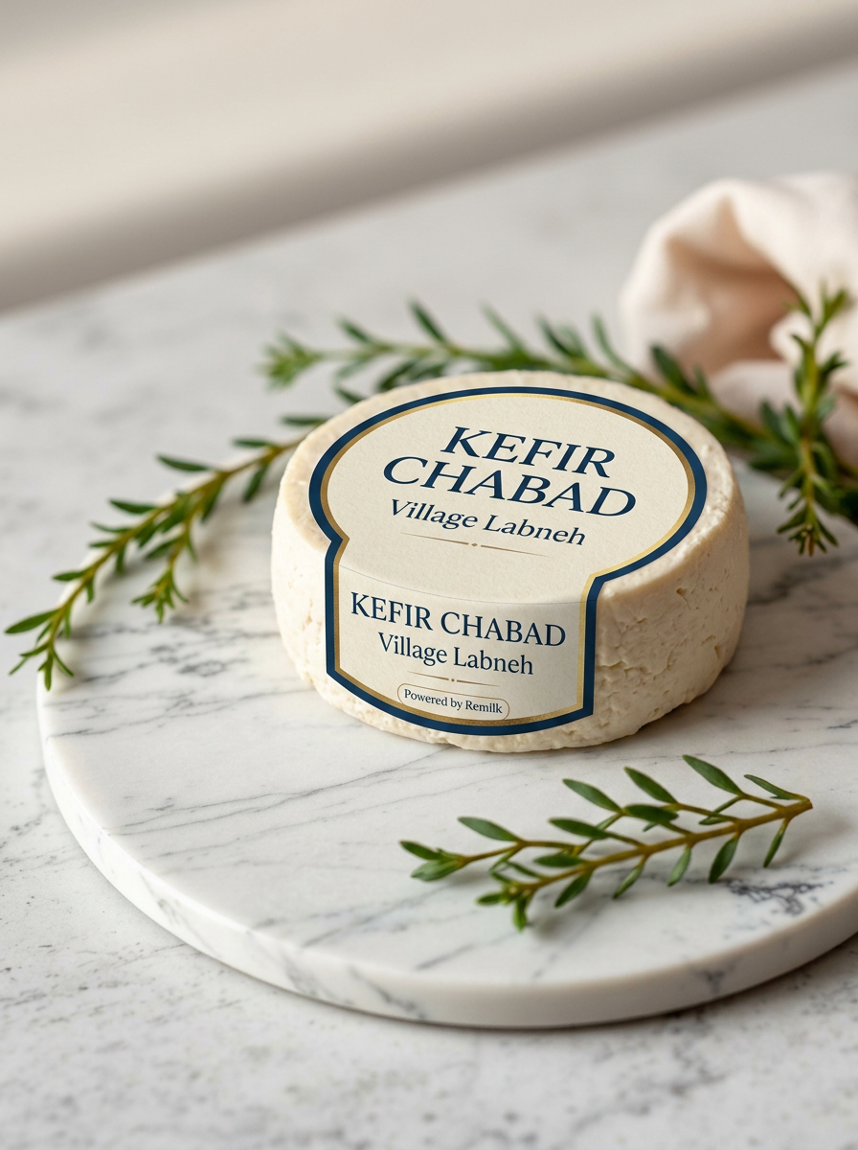
THE PRODUCT LINE
Three SKUs at launch. One protein.
Kefir
Yogurt
Soft Cheese
כפיר
יוגורט
גבינה
Six flavors · 200ml & 750ml
Six flavors · 150g cup & 500g tub
Six flavors · 250g jar
Kefir Chabad · כפיר חב״ד
5 / 11

Slide 6
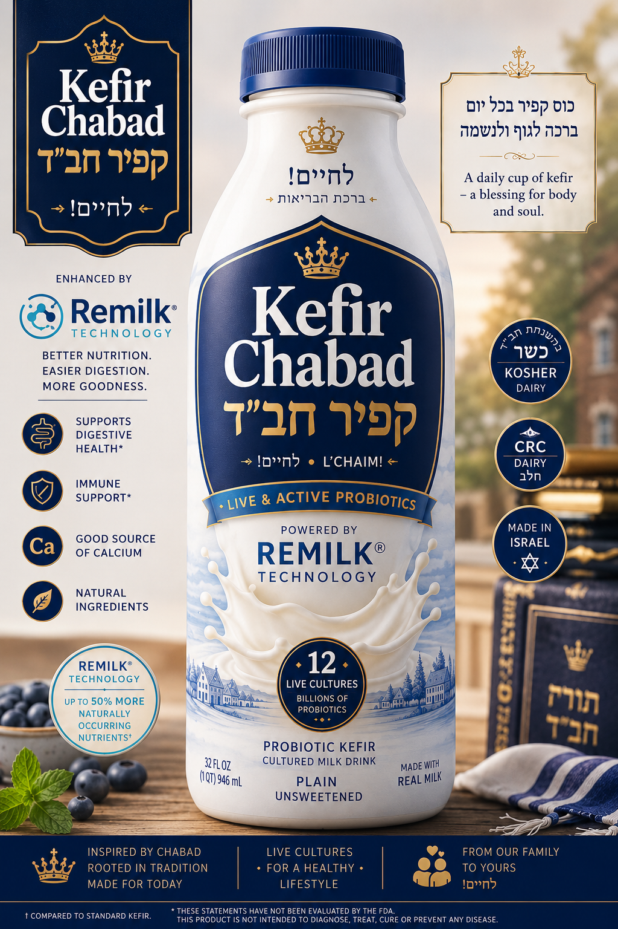
PACKAGING
A label that earns the shelf.
Bilingual Hebrew–English typography. Kosher-pareve mark front-and-center. Remilk's logo present, trusted, never shouted. The bottle reads heritage; the back reads science.
OU Pareve
CRC Certified
Powered by Remilk
Kefir Chabad · כפיר חב״ד
6 / 11

Slide 7
MARKET · ISRAEL
Home market. Built-in trust.
~$420
₪1.2B+
per-capita dairy spend / yr (highest in OECD)
Israeli plant-based & alt-dairy market, growing 12% YoY
70%
6.4M
of Israeli households keep some level of kosher
Jewish Israelis — primary addressable audience
Kefir Chabad · כפיר חב״ד
7 / 11

Slide 8
MARKET · USA
Phase two. Diaspora-led runway.
$1.5B
$24B
US kefir market today · projected $3.2B by 2034
US kosher food market — 12.1M kosher consumers
36%
7.5M
of US adults report lactose intolerance
Jewish Americans — concentrated in NY, NJ, FL, CA
Kefir Chabad · כפיר חב״ד
8 / 11

Slide 9
THE PARTNERSHIP
What each side brings.
REMILK
KEFIR CHABAD
The protein.
The brand.
· Precision-fermented β-lactoglobulin
· Brand identity & bilingual packaging
· Kosher-pareve certification
· Direct line to observant communities
· Regulatory clearance (Israel, US)
· Retail strategy: Rami Levy, Shufersal, Yesh
· Production via Gad Dairies
· Diaspora launch via Kosher distributors
Kefir Chabad · כפיר חב״ד
9 / 11

Slide 10
THE ASK
A pilot.
Kfar Chabad → Tel Aviv → New York.
01
02
03
Q3 2026 — Pilot
Q1 2027 — Israel
Q4 2027 — Diaspora
500 SKUs across 3 Kfar Chabad pilot stores. Six-week sell-through measurement.
National rollout via Shufersal and Rami Levy. Bilingual packaging, kosher-first marketing.
NY/NJ launch via Pomegranate, Seasons, KolSave. East-coast cold-chain via existing kosher distributors.
Kefir Chabad · כפיר חב״ד
10 / 11

Slide 11
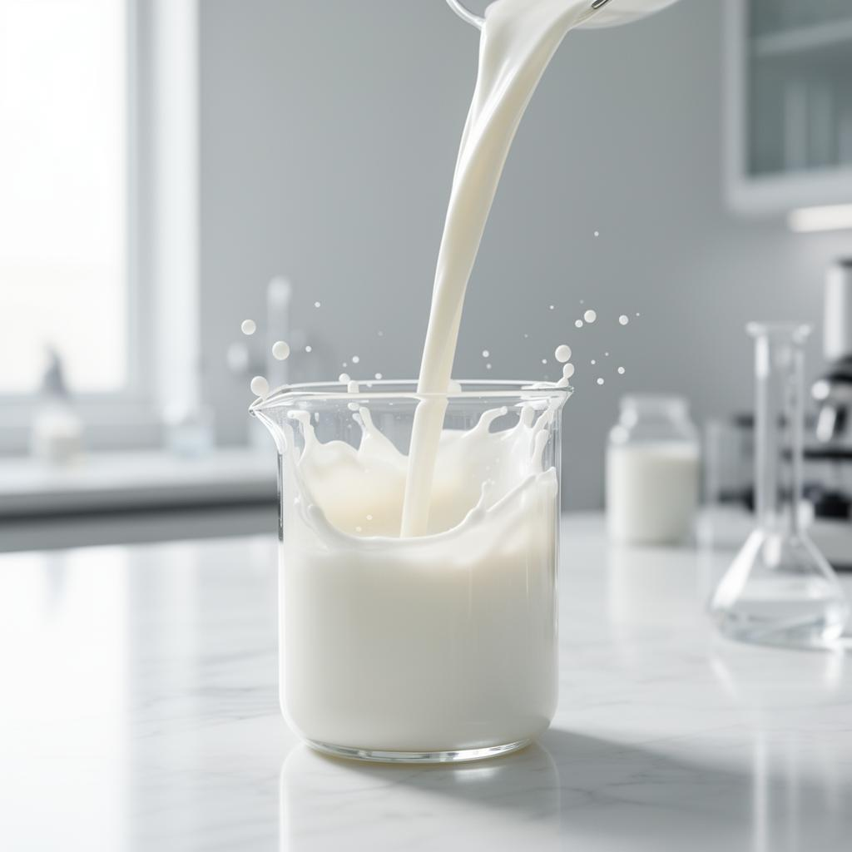
LET'S BUILD IT TOGETHER
The protein is yours.
The story is ours.
The market is waiting.
hello@kefirchabad.co.il
Kfar Chabad, Israel · כפר חב״ד
Kefir Chabad · כפיר חב״ד
11 / 11

